Slide 1
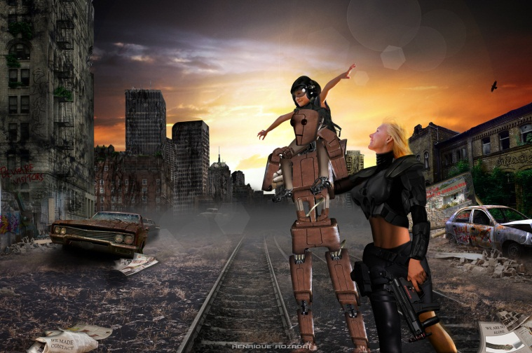
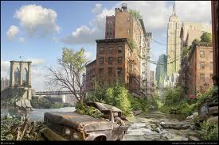
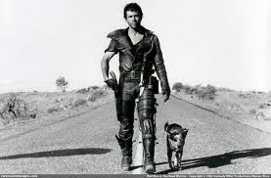
Post-Apocalyptic Worlds: Surviving Together and Apart

Slide 2
Lesson Aims and Objectives:
To explore Post-apocalyptic and dystopian texts
Investigate the themes each text raises and the relevance to contemporary society
Develop ways of taking the texts into the classroom to stimulate analysis of texts.

Slide 3
Introduction:
moving beyond the disaster films
trend in Young Adult fiction
why?
- escapism
- moving away from issue-based fiction
What are the general themes of post apocalypse fiction?

Slide 4
Definitions:
Dystopian fiction: a work of fiction describing an imaginary place where life is extremely bad because of deprivation or oppression or terror
Post-Apocalyptic fiction: a work of fiction set in a world or civilization after a potentially existential catastrophe or disaster

Slide 5
THE FUTURE
How do you see the future? If you were someone living in the salad days of the ‘50s and ‘60s, there were promises of interstellar exploration, flying cars, high tech lifestyles, and meaningful medical breakthroughs. We’d cure all diseases, live like royalty within our own slick scientific reality, and never once worry about modern maladies like hunger, war, or death. This is Utopia, the perfect portrait of a supposed shape of things to come. Yet for every optimist there’s an opposite, a pessimistic perspective that’s part luddite, part ludicrous. It’s not a fear of technology that inspires these people, but where said advances will take us. Eventually, they believe our “U” will turn into a Dystopia, a horrible place where the End Times dictate our destiny.
So within this Judgment Day dynamic, this proposed post-apocalyptic wasteland of warning signs and threats, what would be the worst? Put another way, what would be the best way for a situation set on making humans the last act of a universal staging to work? If texts have taught us anything, it’s that there are lots of likely scenarios, from angry plant life to thought police persecuting the masses. In all cases, like the one presented in the recently released Warm Bodies (now on DVD and Blu-ray) the once bright future has turned shockingly sour, bringing about a dispirited finalé to our time on the planet.

Slide 6
GENRES OF POST APOCALYPTIC FICTION
Warning (ignored)
Cataclysm
Barbarism
Courage
Civility
Re-evaluation
Transformation
Recovery
Demise
Apocalyptic fiction is a sub-genre of science fiction that is concerned with the end of human civilization. This apocalypse is typically portrayed as being due to a potentially existential catastrophe such as nuclear warfare, pandemic, extraterrestrial attack, impact event, cybernetic revolt, technological singularity, dysgenics, supernatural phenomena, divine judgement, runaway climate change, resource depletion, ecological collapse, or some other general disasters. Post-apocalyptic fiction is set in a world or civilization after such a disaster. The time frame may be immediately after the catastrophe, focusing on the travails or psychology of survivors, or considerably later, often including the theme that the existence of pre-catastrophe civilization has been forgotten (or mythologized). Post-apocalyptic stories often take place in a non-technological future world, or a world where only scattered elements of technology remain.
The genre gained popularity after World War II, when the possibility of global annihilation by nuclear weapons entered the public consciousness. However, recognizable apocalyptic novels had existed since the first quarter of the 19th century, when Mary Shelley's The Last Man was published.[1]

Slide 7
Christian Eschatological Imagery
Christian eschatology is a major branch of study within Christian theology. Eschatology, from two Greek words meaning last (ἔσχατος, last) and study (λογία, lit. discourse), is the study of the end of things, whether the end of an individual life, the end of the age, or the end of the world. Broadly speaking, Christian eschatology is the study of the destiny of humankind as it is revealed by the Bible, which is the primary source for all Christian eschatology studies.
The major issues and events in Christian eschatology are death and the afterlife, Heaven and Hell, the Second Coming of Jesus, the Resurrection of the Dead, the Rapture, the Tribulation, Millennialism, the end of the world, the Last Judgment, and the New Heaven and New Earth of the world to come. Eschatological passages are found in many places in the Bible, both in the Old and the New Testaments. There are also many extrabiblical examples of eschatological prophecy, as well as church traditions.

Slide 8
The Book of Revelation
The Book of Revelation, often known as Revelation, Apocalypse,[1] or by a number of variants expanding upon its authorship or subject matter, is the final book of the New Testament and occupies a central part in Christian eschatology. Written in Koine Greek, its title is derived from the first word of the text, apokalypsis, meaning "unveiling" or "revelation". The author of the work identifies himself in the text as "John" and says that he was on Patmos, an island in the Aegean, when he "heard a great voice" instructing him to write the book. This John is traditionally supposed to be John the Apostle, although recent scholarship has suggested other possibilities including a putative figure given the name John of Patmos. Most modern scholars believe it was written around 95 AD, with some believing it dates from around 70 AD.
The book spans three literary genres: epistolary, apocalyptic, and prophetic. It begins with an epistolary address to the reader followed by an apocalyptic description of a complex series of events derived from prophetic visions which the author claims to have seen. These include the appearance of a number of figures and images which have become important in Christian eschatology, such as the Whore of Babylon and the Beast, and culminate in the Second Coming of Jesus Christ. The obscure and extravagant[2] imagery has led to a wide variety of interpretations: historicist interpretations see in Revelation a broad view of history; preterist interpretations treat Revelation as mostly referring to the events of the apostolic era (1st century), or—at the latest—the fall of the Roman Empire; futurists believe that Revelation describes future events; and idealist or symbolic interpretations consider that Revelation does not refer to actual people or events, but is an allegory of the spiritual path and the ongoing struggle between good and evil.

Slide 9
The Book of Revelations
Revelation chapter 14 (NIV)
Then I saw another angel flying in midair, and he had the eternal gospel to proclaim to those who live on the earth--to every nation, tribe, language and people. 7 He said in a loud voice, "Fear God and give him glory, because the hour of his judgment has come. Worship him who made the heavens, the earth, the sea and the springs of water."
14 I looked, and there before me was a white cloud, and seated on the cloud was one "like a son of man" with a crown of gold on his head and a sharp sickle in his hand. 15 Then another angel came out of the temple and called in a loud voice to him who was sitting on the cloud, "Take your sickle and reap, because the time to reap has come, for the harvest of the earth is ripe." 16 So he who was seated on the cloud swung his sickle over the earth, and the earth was harvested.
17 Another angel came out of the temple in heaven, and he too had a sharp sickle.
18 Still another angel, who had charge of the fire, came from the altar and called in a loud voice to him who had the sharp sickle, "Take your sharp sickle and gather the clusters of grapes from the earth's vine, because its grapes are ripe."
19 The angel swung his sickle on the earth, gathered its grapes and threw them into the great winepress of God's wrath. 20 They were trampled in the winepress outside the city, and blood flowed out of the press, rising as high as the horses' bridles for a distance of 1,600 stadia

Slide 10
The Road
by Cormac McCarthy
published 2006
awarded Pulitzer Prize for Fiction, 2009
film adaptation 2009
What relationships are explored in the extract?

Slide 11
The Road
In a New York Review of books article, author Michael Chabon heralded the novel. Discussing the novel’s relation to established genres, Chabon insists The Road is not science fiction’ although ‘the adventure story in both its modern and epic forms … structures the narrative, ultimately it is as a lyrical epic of horror that The Road is best understood.”

Slide 12
PREDICTION
Read through the following statements and decide whether you agree or disagree with each statement. Place an A or D in the first column to indicate what you think.
Show your understanding of before reading the novel and after reading the novel. Did your opinions change, why or why not:
At the heart of most people exists hope and love.
I would do anything, including murder, to protect the ones I love.
If the world as we know it was destroyed and I was still alive, I would do my best to survive.
Apocalyptic writing focuses on the end of days.
Before reading the novel | After reading the novel | Statement | Did your opinion change after reading the novel? Why or why not?
 |  | At the heart of most people exists hope and love.
 |  | I would do anything, including murder, to protect the ones I love.
 |  | If the world as we know it was destroyed and I was still alive, I would do my best to survive.
 |  | Apocalyptic writing focuses on the end of days.

Slide 13
PRE-READING ACTIVITIES.
What do you think is the significance of the road in the novel?
Read the paragraph that ends page 4 and continues on page 5.
  When does the story take place?
  What things indicate the time period?
  What is the “ashen daylight”?
  What is the child’s significance?

Slide 14
PRE-READING ACTIVITIES.
Read the paragraph that ends page 5 and continues on page 6.
  What is the significance of having a mirror?
  If you could take only five items with you to a deserted island, what would they be and why?
Write your version of the ending of the world. How would it happen? Who would survive? What would happen?

Slide 15
SETTING
One can determine in the third paragraph that the setting
for this novel is post-apocalyptic. Three of these sentences from that
paragraph do give us a hint at the setting, but a fourth one doesn’t. Which one does not?
When it was light enough to use the binoculars he glassed the valley below.
The soft ash blowing in loose swirls over the blacktop.
The segments of road down there among the dead trees.
Then he just sat there holding the binoculars and watching the ashen daylight congeal over the land.
DO SOMETHING WITH YOUR ANSWER: Within this same paragraph, we get a good idea about the main characters.
What effect does the setting have on these two characters?
How do the characters interact with their environment?
How does their outlook/attitude change? What is gained? What is lost?

Slide 16
Relationships
the heart of dystopian / post-apocalyptic visions of the future
the human element
ways of commenting on the past whilst presenting a view of the future (memories and flashbacks are common narrative devices)
our relationships juxtaposed with, and placed onto, new landscapes
- how do we (humans) cope?
- what has changed?
- what boundaries have been blurred/crossed?

Slide 17
The Road
‘He’ / ‘Papa’ / ‘the child’ / ‘the boy’
Bleakness of the landscape is a mirror for their loneliness – their relationship is all that is left: ‘each the other’s world entire’ (p.4)
No other reason for living: ‘So I could be with you’ (p.9)
Comment on our present (their past) – supermarket / Cola / newspapers: ‘It’s because I wont ever get to drink another one, isn’t it?’ (p.23)
‘Creedless shells of men’ (p.28)

Slide 18
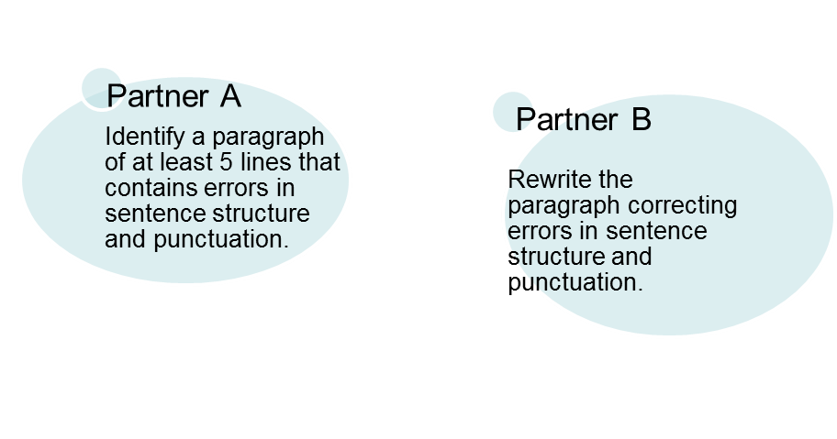
STRUCTURE: How is The Road written?
short sentences / paragraphs mirror the bleakness – pared down speech
the poetic writing shows there’s can be beauty, if not in the landscape
Why does Cormac McCarthy not utilize standard conventions in regards to sentence structure and punctuation?

Slide 19
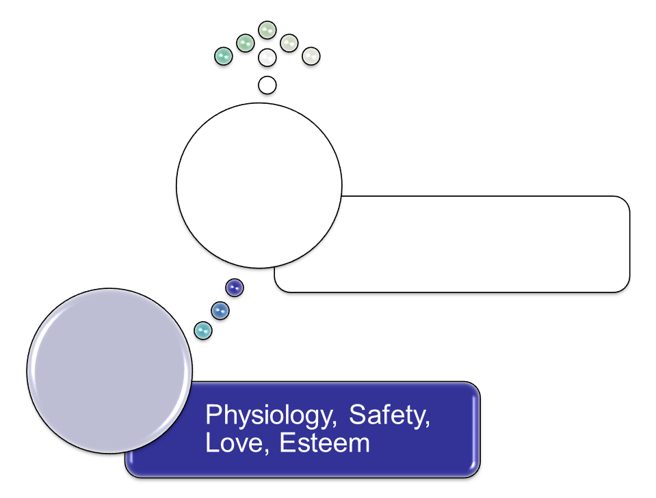
ABRAHAM MASLOW’S
HIERARCHY OF NEEDS
Only 1 in 100 reaches self-actualization
Growth
Basic

Slide 20
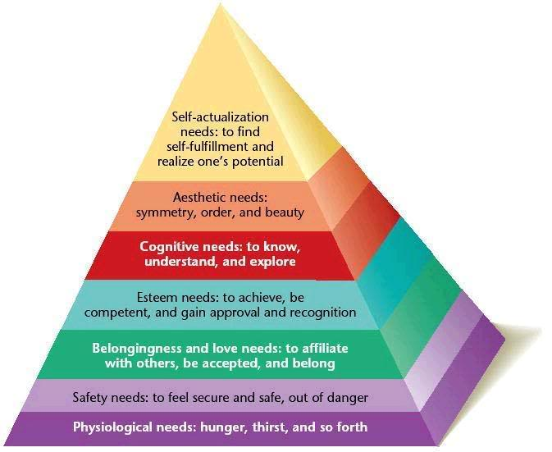
NEEDS PYRAMID
Not original to Maslow

Slide 21

APPLICATION FOR THE ROAD
Consider the father and son. Provide examples of how each character functions at least 3 levels. In what level do you think each character functions the most? Explain your reasoning. How does your analysis confound Maslow’s theory?

Slide 22
themes
Death
Paternal love
Good versus Evil
Trust
Faith and Doubt
Survival and Resilience
Narration: Naming and the Authority of Memory
http://www.gradesaver.com/the-road/study-guide/section11/

Slide 23
STYLE

Slide 24
CHARACTERS
Protagonist: the boy – why? Write ten dot points of why – Give me a good quote here
The man – ten points why give me a good quote here
Flat: Ely, family,
Stock: obvious predictable: road agents
Round: wife,
Antagonist – road agents

Slide 25
POV
Changes third and first – why
Man talks to his wife in his dream
WHY DOES THE POV CHANGE
So Papa can link the past to the present, it also highlights the fact that the boy was born post apocolyptic and therefore has no knowledge of the previous life.

Slide 26
VALUES AND ATTITUDES
Survival/Life
Family/Love
Trust
Humanity
Religion
Compassion
Future Earth – to serve as a warning
Morality

Slide 27
SYMBOLISM
The boy symbolising hope and Jesus, so it’s an analogy of the Bible.
The skulls symbolising death
Eli symbolic as a prophet
The fire – symbolism of humanity
The road symbolises their spiritual journey, as Jesus travelled along a spiritual journey.
Weather/ash – represents death
Bunker – symbolises hope for the future so it’s similar to purgatory, which gives you a direction of where the future will lie.
Trout – swimming maps and mazes, journey as well. Finished, but there is still history there. Symbolic of the Father’s journey, he went through the mazes and maps of the road, he still has his history, but he is now deceased. Also Jesus used trout to feed the thousands from the sermon on the mount.
Christ/Hero journey – symbolising hope in diversity.
Candle symbolises way to light the future, give them hope.
Basement people – symbolises savagery people go through to survive

Slide 28
READING THEORY
Gaps and silences: inferred that the baby was eaten, it’s inferred that the Mother committed suicide
Foreground and privileging: inferred that there was a massive world disaster, such as all out nuclear war
Dominant and resistant readings: It is an alternative reading, as it has a less common ending but is still acceptable to the values of the reader and society.

